Slide 1
D.H. Lawrence: sojourn in Etruria, the Etruscans
Etruria: the Etruscans.
Origin – 1200 BC or 800BC – debatable dates.
Indigenous peoples or driven from another country by the Gauls or immigrated by design from Lydia, Anatolia.
What is clear is their contribution through language and culture to history, to Italy.
Influenced by Greece and perhaps by the Egyptians

Slide 2
Time Line
1200 BC – First traces of Etruscan civilization.
700 BC – Etruscans copy alphabetic writing from Greeks and become first people in Italy to write.
616-579 BV – Rome ruled by its first legendary Etruscan king; Lucius Tarquinius Priscus
550 BC – Etruscan power at zenith. Three confederations hold Po Valley and coast south of Rome, heartland of southern Tuscany and western Umbria. Allied with Carthaginians, Etruscans trade across the Mediterranean.
535BC – At Alalia, off Corsica, fleet of Carthaginians and Etruscans defeat Greek fleet, but Carthaginians, not Etruscans, assert control over seas.
510BC – Last Etruscan king, Lucius Tarquinius Superbus, is expelled from Rome.
474BC – at Cumae, off Naples, Greek fleet defeats Etruscans, who start to lose grip in area south of Rime.
396BC – Romans capture Veii, an Etruscan settlement north of Rome; destruction of settlement marks start of long period in which Romans gradually annex towns of Etruscan heartland. By start of first century BC, all of Etruria has been absorbed by the Roman Republic.

Slide 3
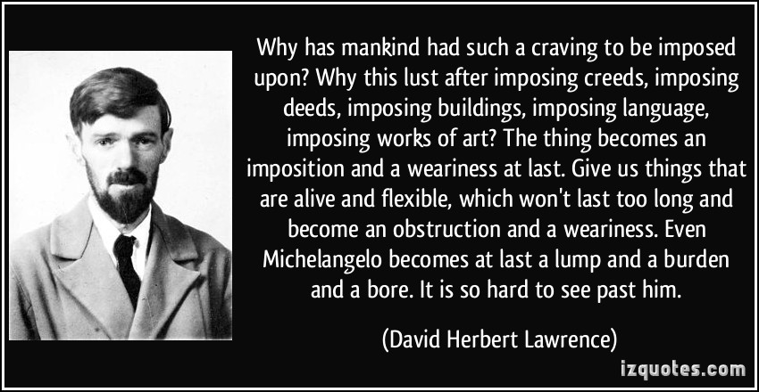
Page 33

Slide 4
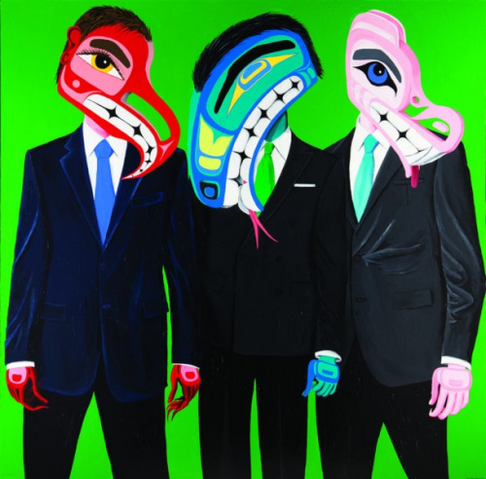
Imposing, or results of, success

Slide 5
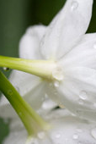
Paperwhite Narcissus macro Flower. Narcissus flowers.

Slide 6
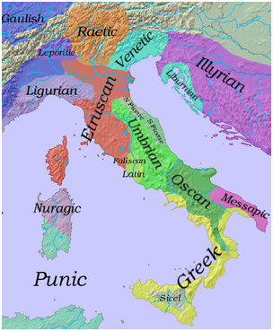
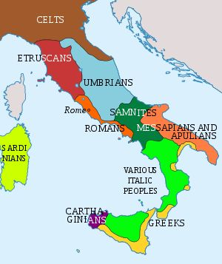
Etruscans history starts in Caere

Slide 7
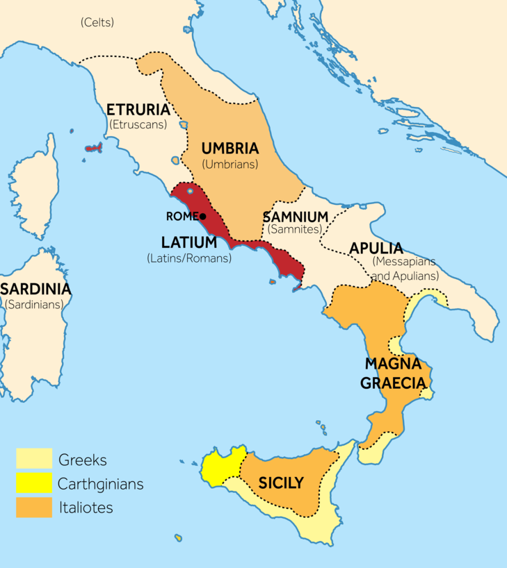

Slide 8
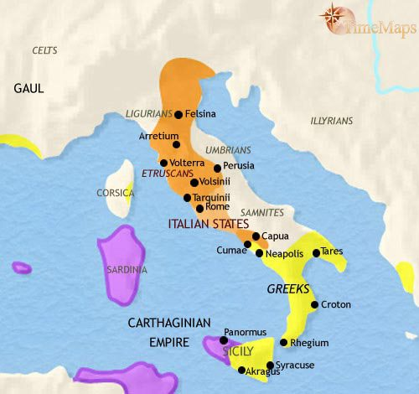
Ancient Italy at the height of Etruscan civilization, 500 BCE

Slide 9
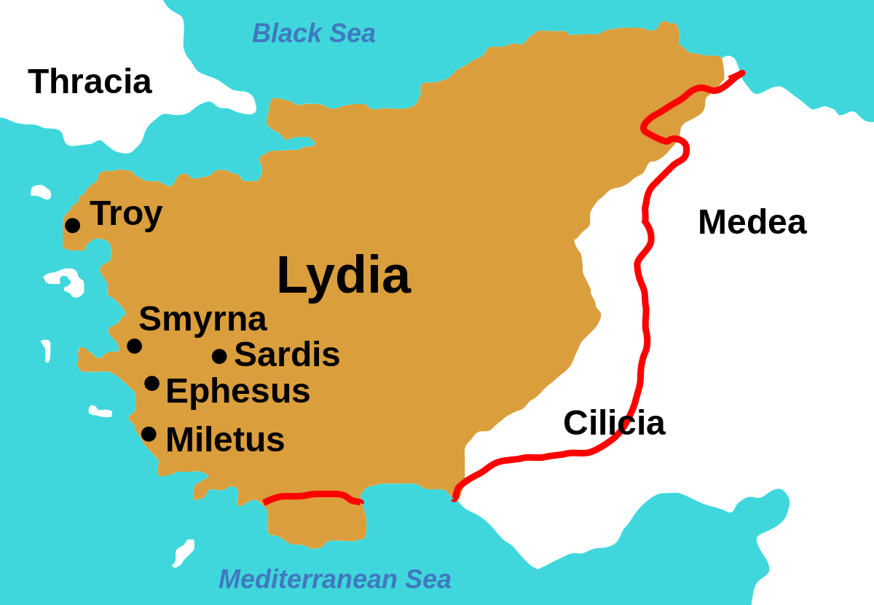

Slide 10
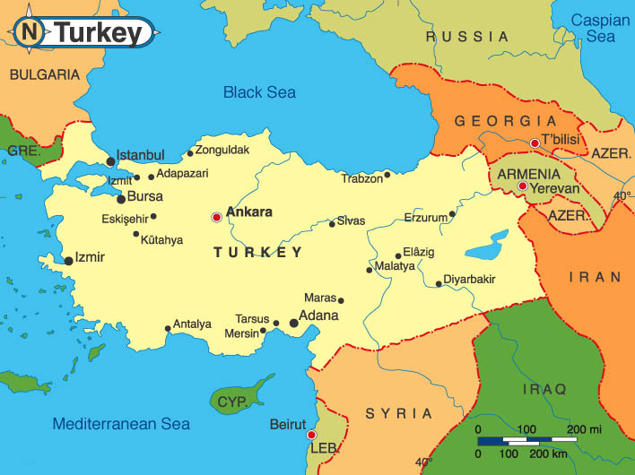

Slide 11
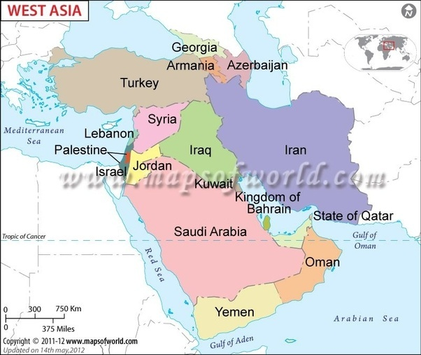
Western Asia countries

Slide 12
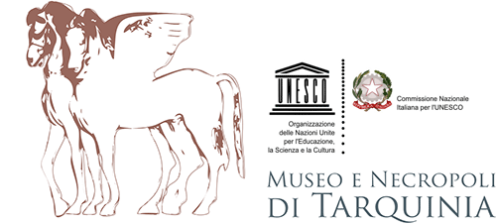
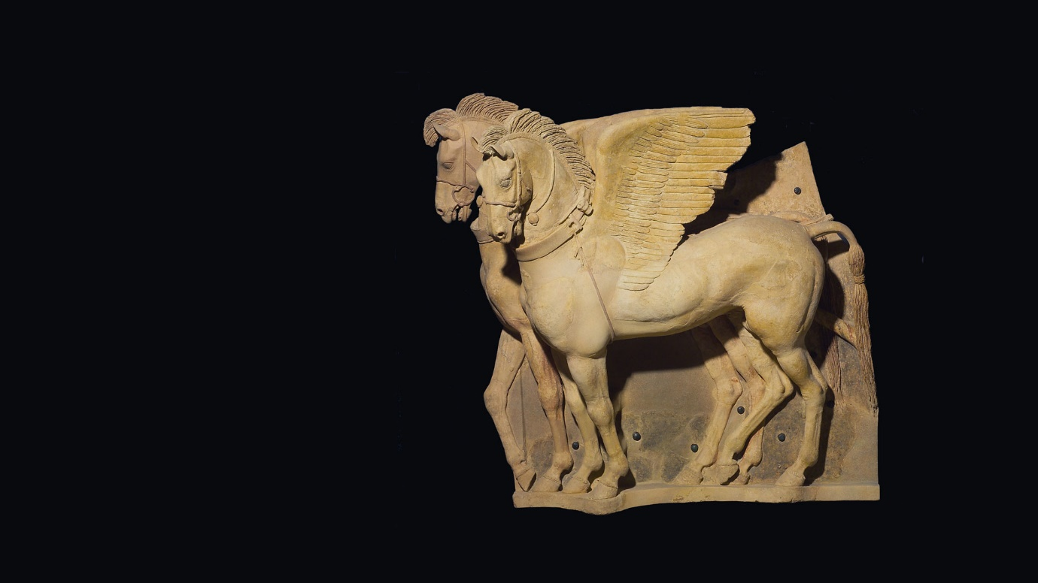
The wonders of the
Etruscans

Slide 13
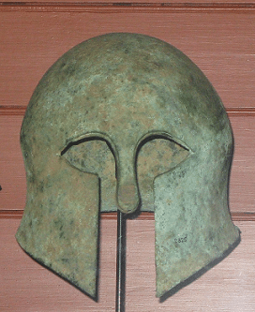
An Etruscan Helmut in the British Museum.

Slide 14
Tombs located in the tumuli of the Banditaccia and located in Cerveteri, Lazio, some distance from Tarquinia.

Slide 15
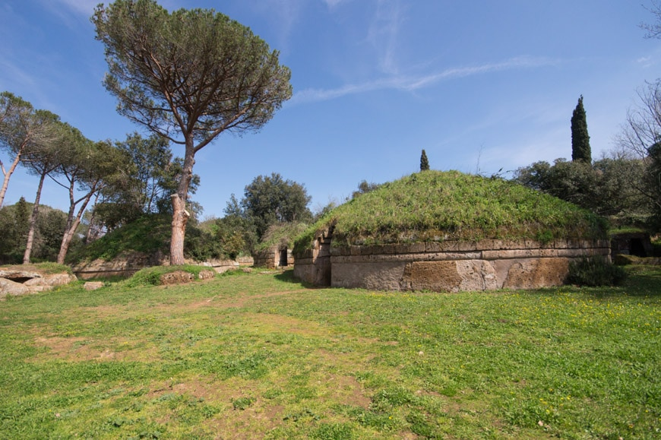

Slide 16
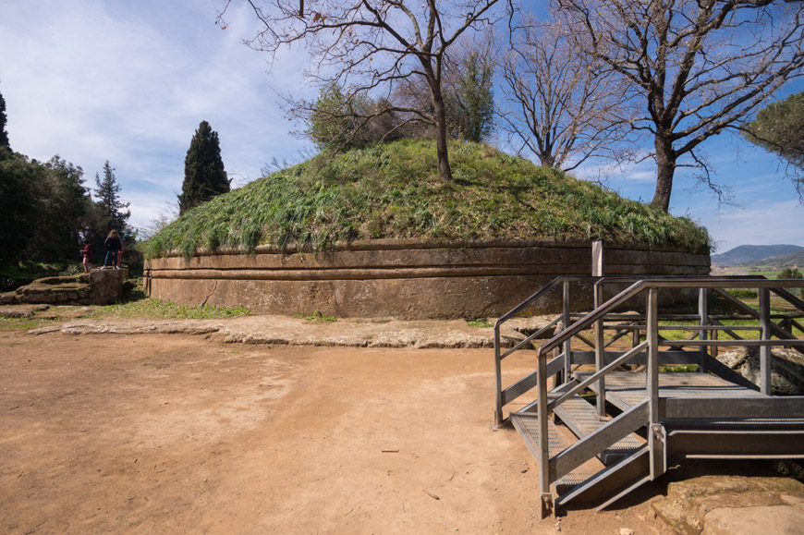
The necropolis “Banditaccia” in Cerveteri, near Rome, is an UNESCO World Heritage Site and the world’s largest Etruscan archaeological site.

Slide 17
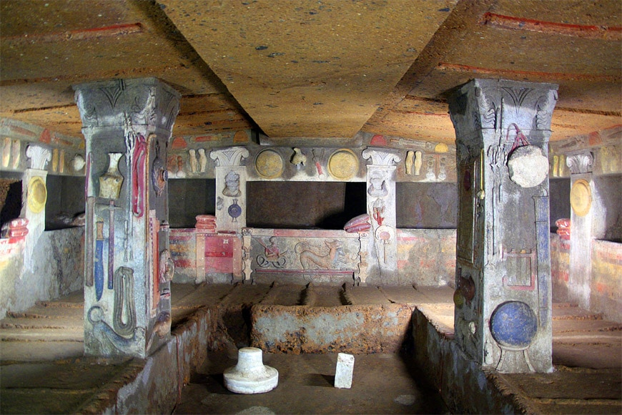
Two damaged busts on the pilasters flanking the central niche possibly depict the divinities Aita (ruler of the underworld) and Persipnei, (queen of the underworld).
Interior view of the “Tomb of the Reliefs”, one of the few decorated tombs in Cerveteri, dating back to the 3rd century BC; photo Roberto Ferrari

Slide 18
Tin/Tinia, head of the pantheon

Slide 19
Two Etruscan votive bronze statuettes of Menerva the warrior (Athena) wearing a high-crested Attic helmet and a cuirass with the gorgoneion, 450-400 BCE. (National Etruscan Museum of Villa Giulia, Rome)

Slide 21
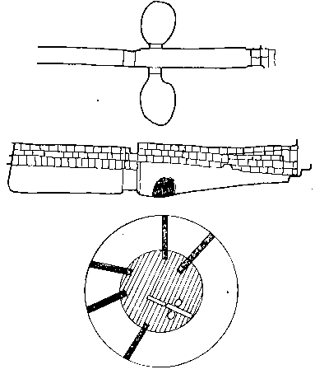
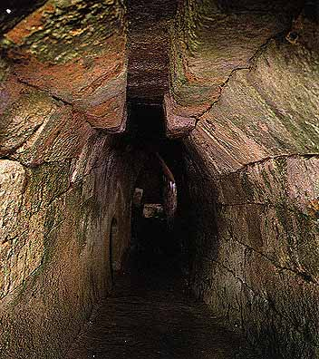
Three levels in the burial ground.

Slide 22
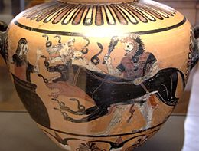
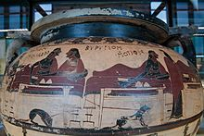
An ancient Etruscan vase from Caere (ca 525 BC) depicting Heracles presenting Cerberus to Eurystheus.
Example of Greek-style pottery in Caere. Eurytus and Heracles in a symposium. Krater of corinthian columns called 'Krater of Eurytus', circa 600 B.C.

Slide 23
There is speculation that the Etruscans may have had a similar belief to Egyptians in that part of the soul remained with the body.

Slide 24
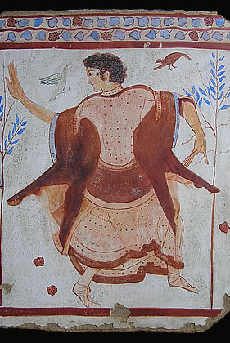
The lyre player. The dancer.

Slide 25
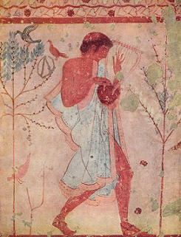
5th century BC fresco musician, tomb of the leopards.

Slide 26
Etruscan Necropolises of Cerveteri and Tarquinia.

Slide 27
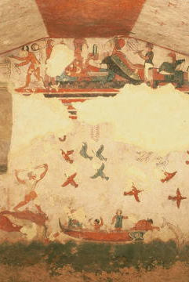
Etruscan Necropolises of Cerveteri and Tarquinia.

Slide 28
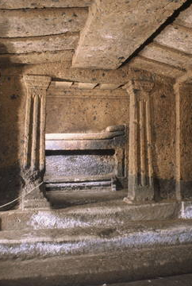
Etruscan Necropolises of Cerveteri and Tarquinia.

Slide 29
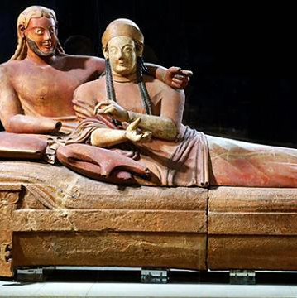
Etruscan Necropolises of Cerveteri and Tarquinia. Sarcophagus of the Bride and Bridegroom. Produced by the Etruscans, it served as an ornate burial container for citizens in a civilisation that believed very strongly in the afterlife. It was created sometime between the years 520 and 510 BC.

Slide 30
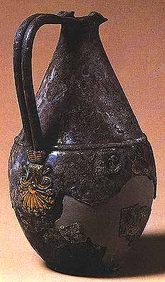
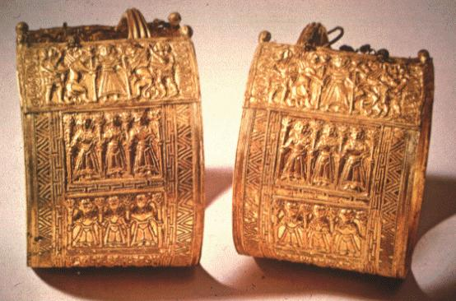

Slide 31
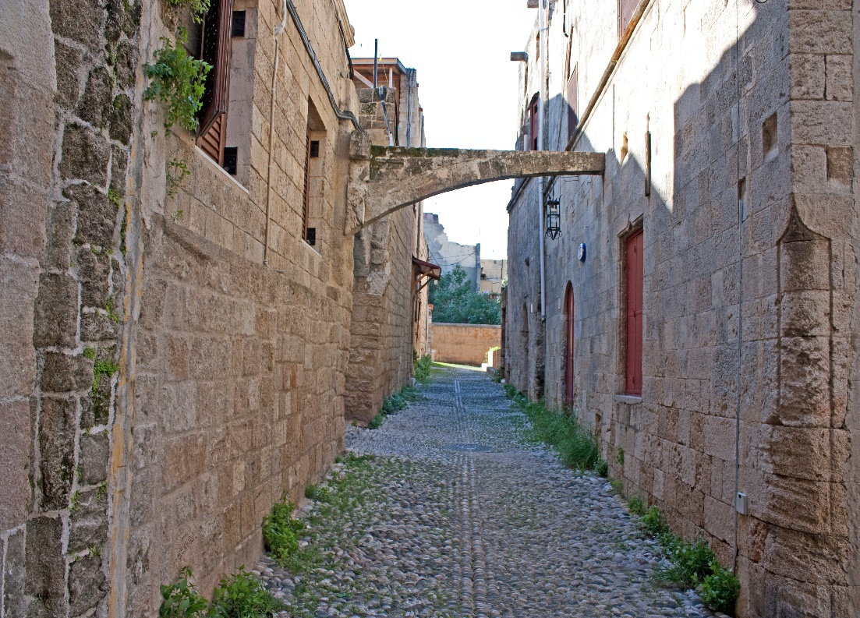
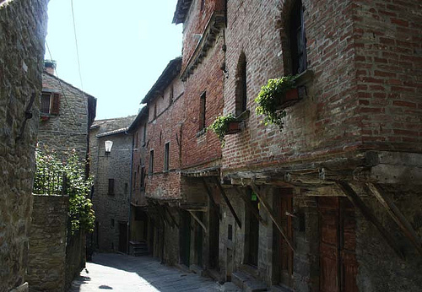
Tarquinia today.

Slide 32
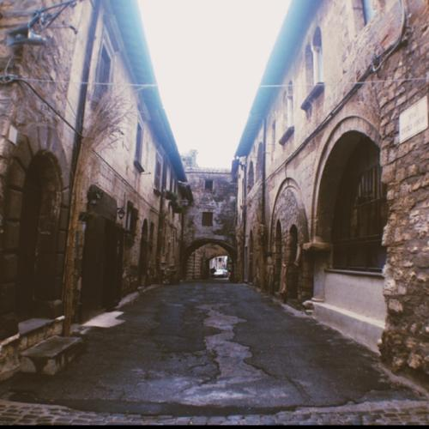
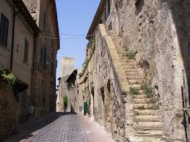
Tarquinia today.

Slide 33
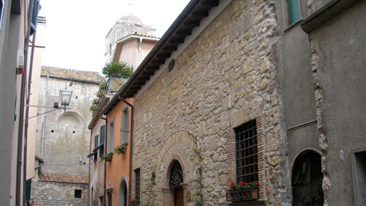
Tarquinia today.

Slide 35
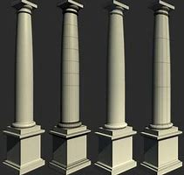

Slide 36
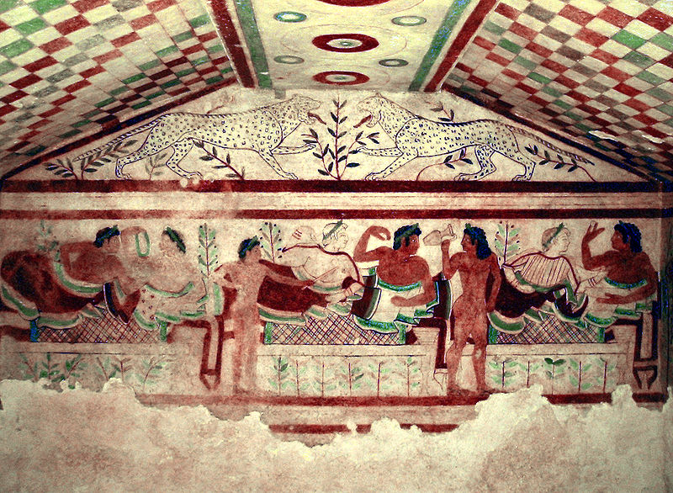
Confronting leopards above a banqueting scene in the Tomb of the Leopards.

Slide 37
Layout: Rectangular (3x 4 x 2.5 metres). The frescos depict banqueting scenes. Ceiling: Polychrome chequer board pattered. The column is decorated with concentric circles (the circles symbolise time). Fronton: the mensola is absent, replaced by a small olive tree, with a leopard at each side. The fresco only uses two colours. Main Wall: three clines are shown. Every cline is matrimonial, i.e. for both man and woman (contrast with the Greek custom where women were excluded from the banquet).

Slide 38
The central cline is covered with cloth, the two shown banqueting (perhaps relatives of the deceased) look towards a servant who is carrying an oinochoe or wine jug. Under the cline there is a series of small trees, which give an impression of the rural landscape in which the funeral banquet is carried out. The couple on the left hand cline appear to be engrossed in conversation without paying any attention to the others. The man on the right hand cline is offering a large egg to the woman. The egg is a symbol of life after death (cf. Easter eggs in the Christian tradition). All are wearing crowns of laurel for the festive occasion.

Slide 39
5th century BC fresco of dancers and musicians. Tomb of the Leopards, Monterozzi Necropolis, Tarquinia, Italy.

Slide 40
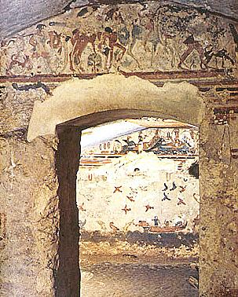
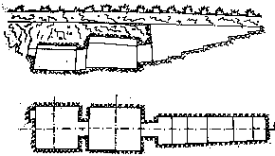
The Tomb of Hunting and Fishing Tomba caccia e Pesca Period: end of the VI century BC. Artists: Ionian school.
main wall

Slide 41
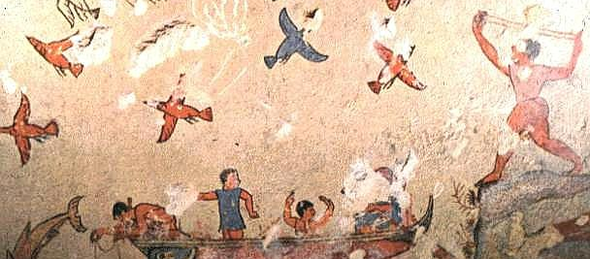
Four fishermen: one intent on rowing- the others fishing, perhaps with a net. From the water multi coloured dolphins and a seagull appears on the surface. .

Slide 42
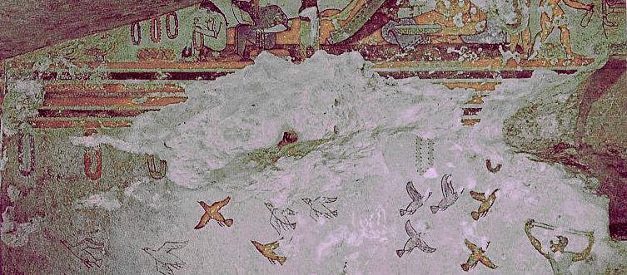
A youth is diving, after having disrobed; another youth is scurrying to join in. In the mid-distance, on a boat, a spectator seems to applaud them. Right wall: Here we find a second hunter and a fisherman with harpoon.

Slide 43
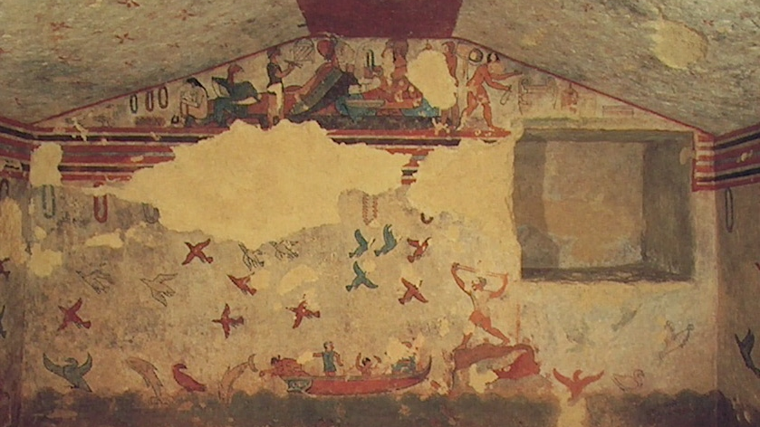

Slide 44
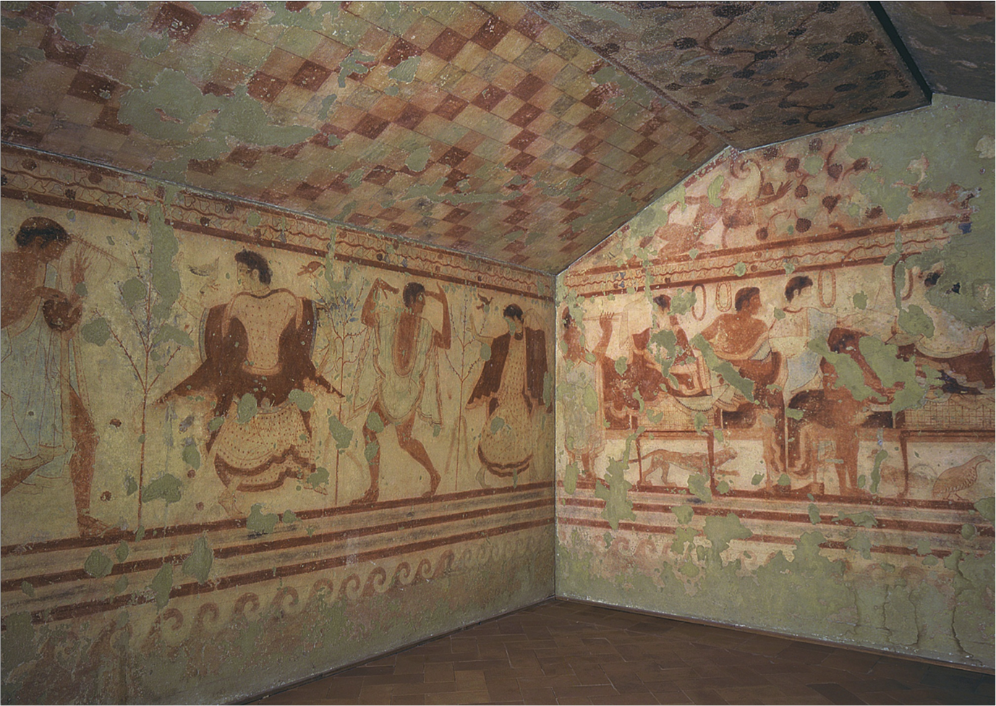

Slide 45
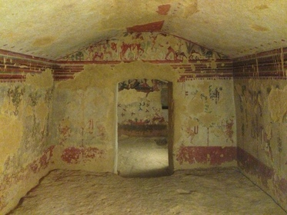

Slide 46
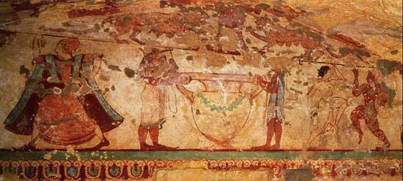

Slide 47
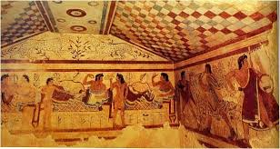
Tomb of the Leopards.

Slide 48
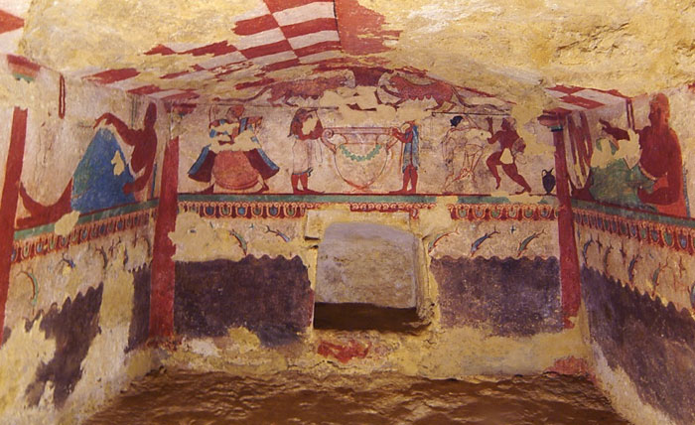
The wide ceiling of the tomb is decorated with a brown and white
chessboard pattern.

Slide 49
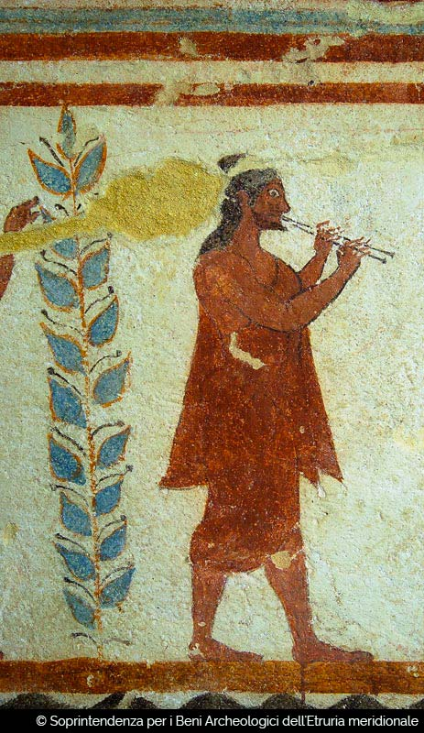
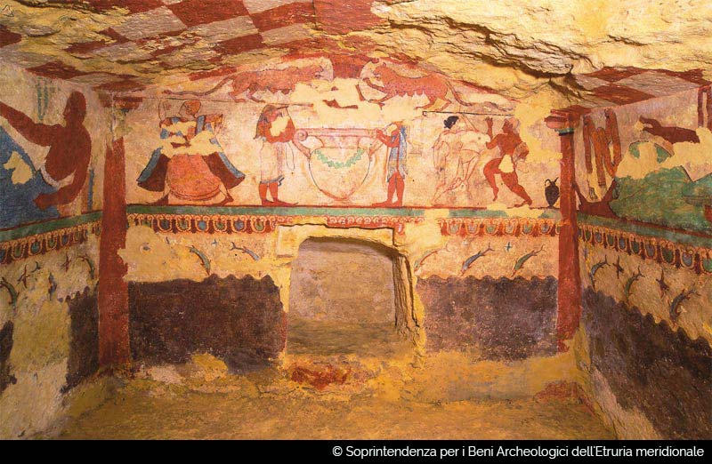

Slide 50
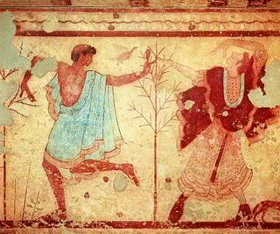

Slide 51
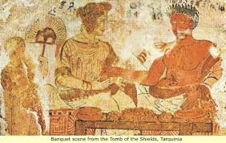

Slide 52
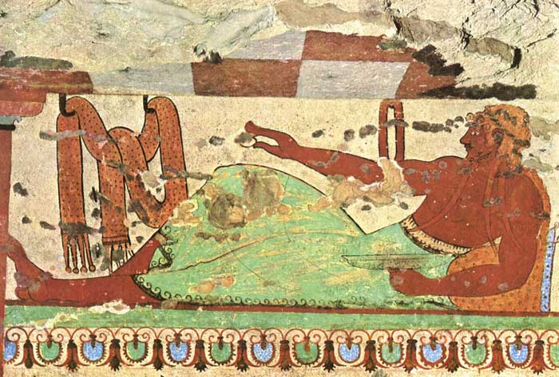
Tomba delle Lionesses – The Tomb of the Lioness.
The man is offering an egg which is a common symbol of the Etruscan afterlife.
Rebirth!!

Slide 53
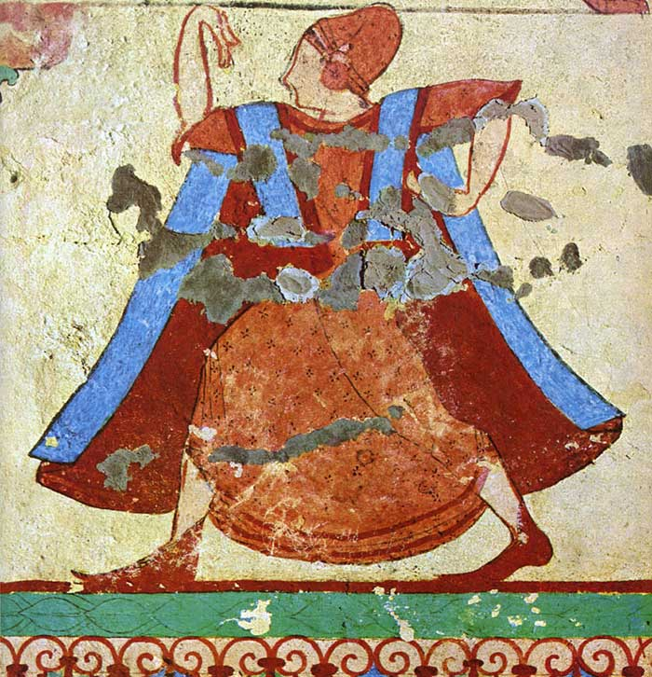
Woman wearing a tutulus, detail of the rear wall of the Tomba delle Leonesse, Tarquinia

Slide 54
The young man carries a metal olpe, or jug, and in the young lady's right hand are castanets.

Slide 55
Tomb of the Bulls, symbolic and not pornographic.

Slide 56
The frescos on this tomb are characterised by fertility symbols, although the meaning of some of the symbolism is not entirely clear. The panel on the left depicts a heterosexual scene involving two couples, whereas the scene on the right depicts a homosexual scene. This has been variously interpreted. It is noted that the bull on the right has an aggressive pose, whereas the bull on the left is completed passive, which has been interpreted by some authors as a disapproval of homosexuality. Note also that the bulls have human faces, possibly indicating some mythological context.

Slide 57
Achilles and Troilus.

Slide 59
Etruscan leather boots and sandals. P. 121:11

Slide 60
An augur, a religious leader.

Slide 61
The Tomb of The Augurs Tomba Dei Augures. Period: 530 - 480 BC

Slide 62
Possibly funerary games.

Slide 63
probably part of the funerary games, and depicts a masked figure holding a rope in his hand. The rope is attached to the collar of a dog. When the Phersu (masked person) pulls on the rope, a nail on the dog's collar bites into its neck, enraging the animal and causing it to attack a tethered man, possibly a condemned criminal. Up until recently the names of the characters could be read.

Slide 65
The Tomb of The Typhon.
Rare example of he late Etruscan period - when Romans ruled Etruria

Slide 66
Tomb of Isis from Vulci. Now in British Museum.

Slide 67
A battle scene of Etruscans fighting Romans in the guise of mythical figures.
From the Francois Tomb at Vulci. c. 350 BC.

Slide 68
Etruscan pendant with swastika symbols from Bolsena, Italy700-650 BC. Louvre.
Swastikas meant good
fortune and well being

Slide 69
Etruscan frieze; in the National Archaeological Museum, Siena, Italy.

Slide 70
Volterra & San Giusto Church.
According to Lawrence the architects achieved nothing with the height of the building.

Slide 71
John Sargent’s (leading artist of the day) art which Lawrence dismissed as nothing compared with Etruscan art, saying one Etruscan leopard and the littles quail is far better than Sargent’s art.
Left: Morning Walk. 1888
Right: Rosina. 1987

Slide 73
Websites.
https://www.britannica.com/topic/ancient-Italic-people#ref249577
http://www.artoffresco.com/03-History/03.4-tarquinia/03.4-history-tarquinia.htm
http://whc.unesco.org/en/list/1158
http://www.tarquinia-cerveteri.it/en/museum-and-necropolis-of-tarquinia/museum
http://www.mysteriousetruscans.com/tarqhf.html
http://www.mysteriousetruscans.com/tarbulls.html
http://www.bbc.co.uk/programmes/b0151q7j
https://www.inexhibit.com/mymuseum/necropolis-of-cerveteri-etruscan-archaeological-site-rome/
https://www.timemaps.com/history/italy-500bc/
https://archive.archaeology.org/1011/abstracts/etruscan.html
https://www.timemaps.com/civilizations/etruscans/
https://en.wikipedia.org/wiki/Etruscan_origins
http://www.mysteriousetruscans.com/tarleop.html

Slide 74
Websites (cont.)
https://www.bing.com/images/search?q=map+of+lydia&id=D0173C0D1632D9F259AF079EEF28ECFE6E7E4EB9&FORM=IQFRBA
https://www.bing.com/search?q=map+of+turkey&pc=MOZD&form=MOZLBR
https://history2701.fandom.com/wiki/Sarcophagus_of_the_Spouses
https://www.ancient.eu/Etruscan_Warfare/
https://www.ancient.eu/image/6258/battle-scene-francois-tomb-vulci/
https://www.bbc.co.uk/blogs/radio4/entries/abd083df-7743-3904-b24f-83d725e18921
https://en.wikipedia.org/wiki/Etruscan_civilization#/media/File:Etruscan_pendant_with_swastika_symbols_Bolsena_Italy_700_BCE_to_650_BCE.jpg
http://www.mysteriousetruscans.com/religion.html
http://www.bbc.co.uk/blogs/radio4/entries/abd083df-7743-3904-b24f-83d725e18921
https://www.ancient.eu/image/5541/etruscan-votive-statuettes-of-menerva-athena/
https://www.ancient.eu/image/6397/tin/

